Slide 1
Advanced Web Design
Presented by Joy Karani

Slide 2
agenda
INTRODUCTION 3
RESPONSIVE WEBSITES 4
FORMS 7
ANIMATIONS AND TRANSITIONS 10
Q&A SESSION 12

Slide 3
What is a Landing Page?
A landing page is a standalone web page created specifically for a marketing or advertising campaign.
It’s where a visitor "lands" after they click on a link in an email, or ads from Google, YouTube, Facebook, Instagram, Twitter, or similar places on the web.

Slide 4
Responsive Websites
Responsive design ensures your website looks good on all devices, from desktops to smartphones.
To create a responsive website, add the following <meta> tag to all your web pages
We'll discuss the mobile-first approach and key principles like fluid grids, flexible images, and media queries.

Slide 5
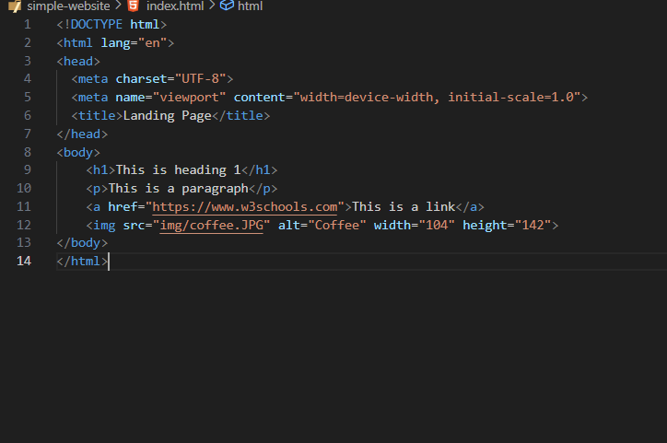
Basic HTML Structure

Slide 6
Media Queries
Media queries allow you to apply styles based on device characteristics like screen width.
Syntax - @media rule
There are different styles for different screen sizes.
i.e.
@media screen and (max-width: 600px) {
body {
background-color: blue;
}}

Slide 7
Forms
The HTML <form> element creates an HTML form for user input.
The HTML <input> element is used in the form element and can be displayed in many ways, depending on the type attribute.
The <label> tag defines a label for many form elements
i.e: <input type="text">
<input type="checkbox">
<input type="submit">
<input type="button">

Slide 8
Forms
<form action="/submit" method="POST">
<label for="name">Name:</label>
<input type="text" id="name" name="name“ required>
<input type="submit" value="Submit">
</form>

Slide 9
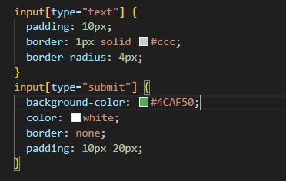
Basic Form Styling with CSS

Slide 10
Animations and Transitions with CSS
CSS animations and transitions add dynamic effects to your web elements
CSS transitions allow you to change property values smoothly, over a given duration.
Properties include: transition, transition-delay, transition-duration, transition-property, transition-timing-function
An animation lets an element gradually change from one style to another using the @keyframes rule.

Slide 11
Transition example
Button hover
button {
background-color: #3498db;
cursor: pointer; transition: background-color 0.3s ease, transform 0.3s ease, color 0.3s ease;
}
button:hover {
background-color: #2ecc71;
color: #ffffff;
transform: scale(1.1);
}

Slide 12

Live Coding Session
Step-by-step Coding Demonstration
Implementing Responsive Design, Forms, and Animations

Slide 13
Q&A, final tips & takeaways
further LEARNING
W3Schools - Beginner-friendly site with tutorials, references, and examples for HTML, CSS, and more.
freeCodeCamp - Offers a full curriculum on web development, including HTML and CSS, with interactive coding challenges and projects
MDN Web Docs - Provides comprehensive and up-to-date documentation and tutorials on HTML, CSS, JavaScript, and other web technologies.

Slide 14

thank you

